Slide 1

Medical Store Management System
CAPSTONE PROJECT
Md. Sameul Hasan 232-35-334
Roktim Saha 232-35-558
Md Shahriar Anas Khan 232-35-208

Slide 2

Introduction
The Medical Store Management System is a comprehensive solution designed to manage pharmacy operations efficiently. It allows users to add, update, and browse medicines, while also tracking stock and handling sales transactions. The system generates detailed bills with tax calculations, medicine details, and expiry checks. It ensures data integrity with proper file management and error handling. With its user-friendly interface, the system simplifies pharmacy management, ensuring accurate billing and inventory control.

Slide 3

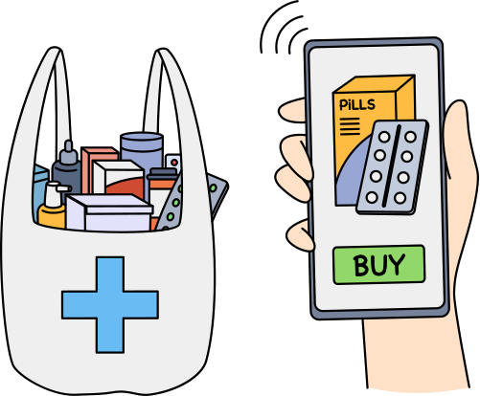
Feature of this system:
Inventory Management: Add, update, delete, and manage medicines with unique IDs, names, quantities, prices, and expiry dates while preventing duplicates.
Search and Browse: Find medicines using case-insensitive and partial/fuzzy search, with results showing detailed information in a user-friendly format.
Add to Cart: Seamlessly add medicines to a cart with stock validation, real-time updates, and dynamic tracking of items.
Checkout Process: Generate a detailed cart summary with subtotals, tax calculation, and a grand total, updating inventory automatically after purchase.
Generate Bills: Create and log bills with unique serial numbers, customer details, date-time, and a color-coded summary.
File Management: Persistent storage for inventory, temporary files for safe updates, and robust error handling for file operations.
Data Validation: Prevents invalid inputs, checks for expired medicines, and ensures data consistency across all operations.
Test Data Support: Easily loads large test datasets, compliant with dd-mm-yyyy expiry date format.
User-Friendly Interface: Features a colorful, text-based UI, intuitive navigation, and helpful prompts for a smooth experience.
Customizable Options: Configurable tax rates and search sensitivity for tailored use cases.

Slide 4
Implementation :
WE USED THE C PROGRAMMING LANGUAGE.
WE USED LIBRARIES LIKE
STDIO.H - FOR STANDARD INPUT AND OUTPUT OPERATIONS.
STDLIB.H - FOR MEMORY ALLOCATION, RANDOM NUMBER GENERATION, AND PROGRAM TERMINATION.
STRING.H - FOR STRING MANIPULATION FUNCTIONS LIKE STRCPY, STRSTR, ETC.
CTYPE.H - FOR CHARACTER HANDLING FUNCTIONS LIKE TOLOWER.
TIME.H - FOR WORKING WITH DATE AND TIME FUNCTIONS.
WE HAVE TO USE DIFFERENT TYPES OF VARIABLES, MULTIDIMENSIONAL ARRAYS, AND STRUCTURES, TO STORE INFORMATION.
WE WILL USE LOOPS, AND CONDITIONS, TO TRAVERSE DATA, PROCESS IT, COMPARE DATA, ETC.
WE USED USER-DEFINED FUNCTIONS TO DIVIDE THE LARGE PROJECT INTO SMALL OPERATIONS, LIKE INSERTION, DELETION, ETC. SOME ARE GIVEN BELOW :
addMedicine() , updateInventory() , browseMedicine(), checkExpiry(), generateBill(), addToCart(), checkout(), removeMedicine()
WE USED FILE HANDLING TO STORE DATA LOCALLY OR EXPORT IT

Slide 5
How does the project work?
OUR VISION OF THE PROJECT
The pharmacy management system efficiently handles inventory and billing operations. Users can manage medicines by adding, updating, or deleting entries. A browse feature allows searching by name, while the cart and checkout system enables streamlined purchasing with stock validation. The program generates detailed bills with itemized summaries, unique serial numbers, and tax calculations. Inventory updates automatically after transactions, ensuring data integrity. It features error handling for expired medicines, low stock, and duplicate IDs, offering a user-friendly and reliable interface.

Slide 6
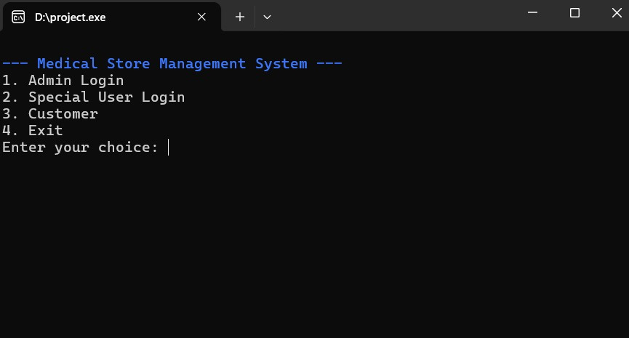
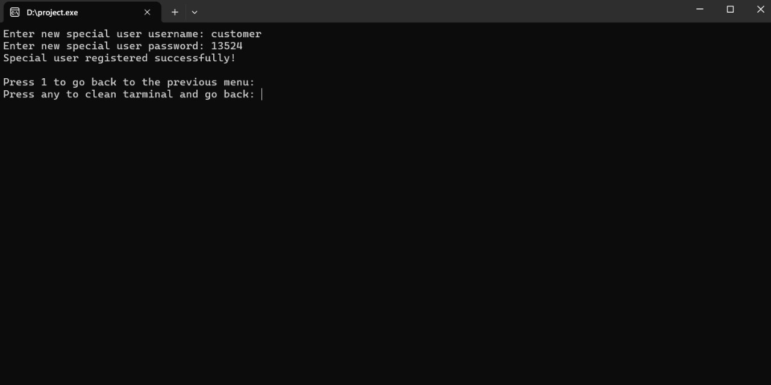
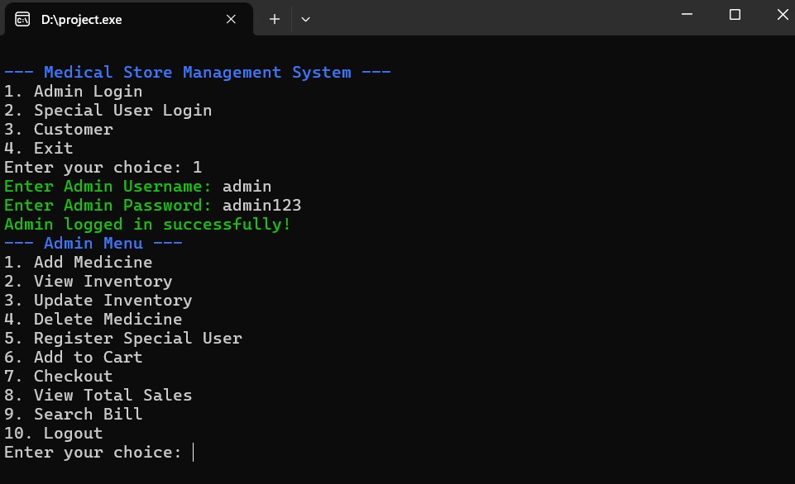
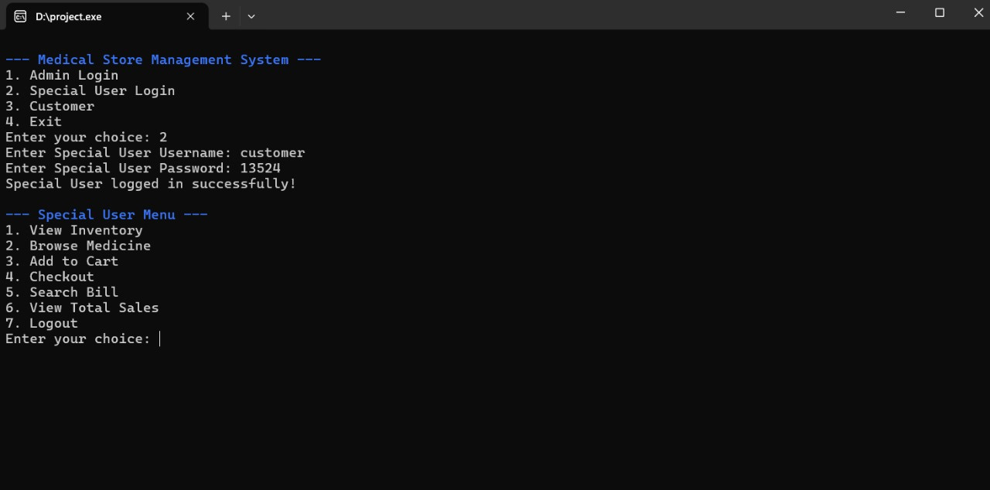
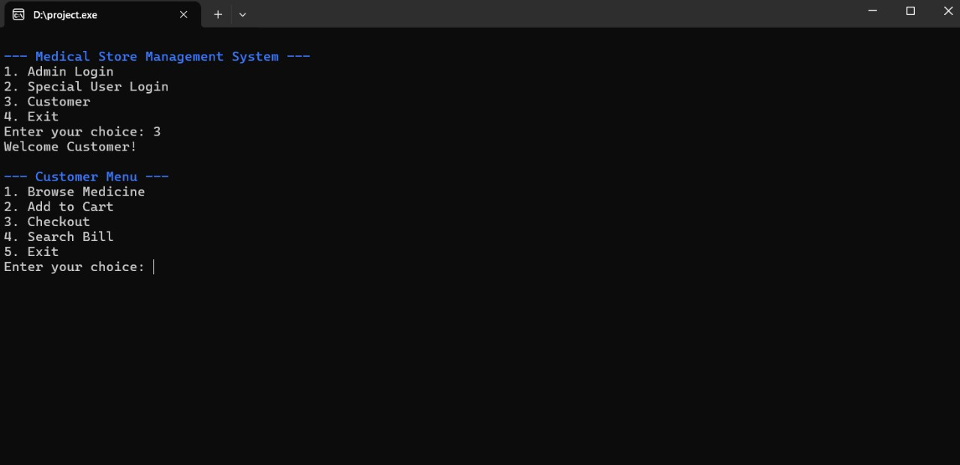
Homepage of this system
If a special user wants to log in, he must first enter the data through the admin.
Admin Log in and panel of this system
Special User Log in and panel of this system
Costumer panel of this system

Slide 7
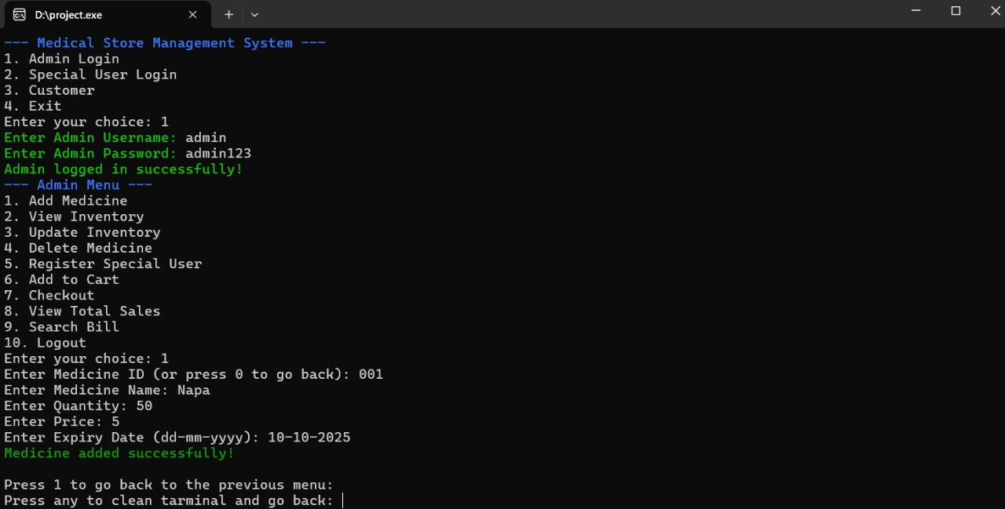
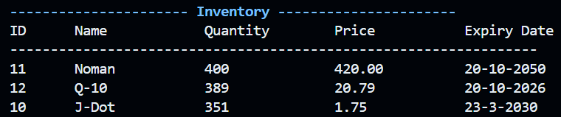
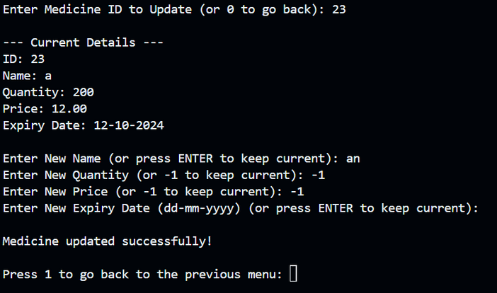
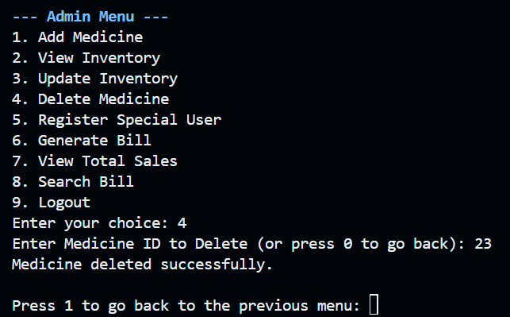
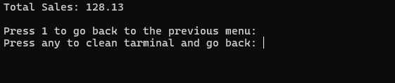
Add medicine
View Inventory
Update Inventory
Delete Inventory
Total Sales

Slide 8
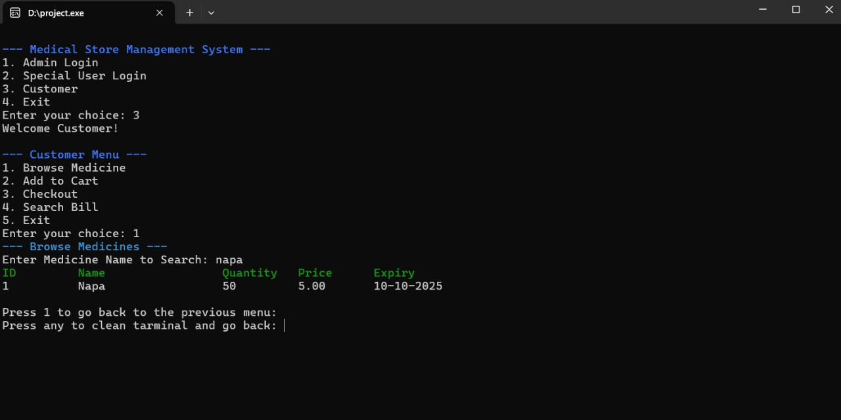
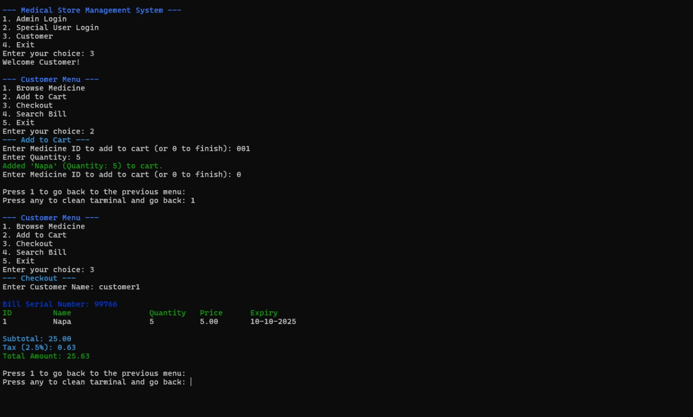
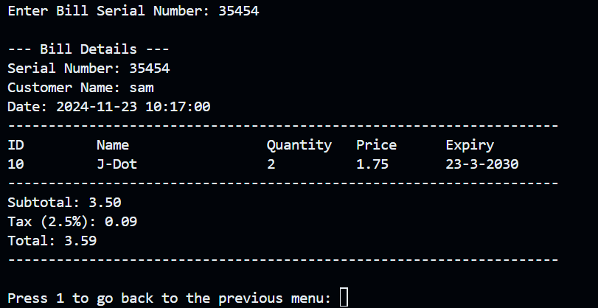
Customer Panel
Browse Medicine
Add curt and check out
Search Bill

Slide 9
Conclusion:
The Medical Store Management System is a practical and feature-rich program for handling a pharmacy's operations. It allows for seamless management of inventory, billing, and user interactions through distinct roles (Admin, Special Users, and Customers). The program ensures efficient stock tracking, real-time sales reporting, and secure access, making it a valuable tool for pharmacy management. Its modular design and error-handling make it reliable for day-to-day use.
Drawback:
Despite its functionality, the program has some limitations:
No Database Integration: It relies on file handling, which can lead to slower performance and scalability issues for larger datasets.
Limited Security Measures: User authentication is basic, lacking encryption and modern security practices.
No Graphical User Interface (GUI): The command-line interface may not be user-friendly for all users.
Concurrent Access Issues: Multiple users cannot access or modify the inventory simultaneously, limiting its real-world applicability.
Error Prone: Manual input of inventory data might lead to data inconsistencies or errors.

Slide 10

Thanks for your attention!

